Slide 1
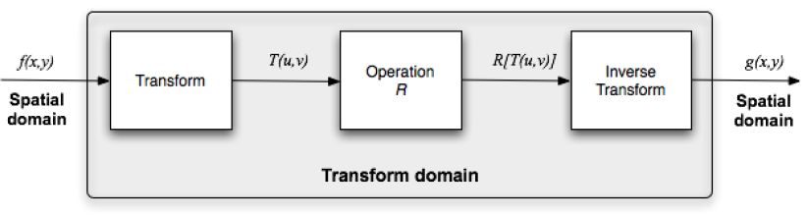
Overview of image processing operations
Spatial domain
Transform domain (Frequency Domain)
COMSATS University Islamabad, Lahore Campus Digital Image Processing CSD 331

Slide 2
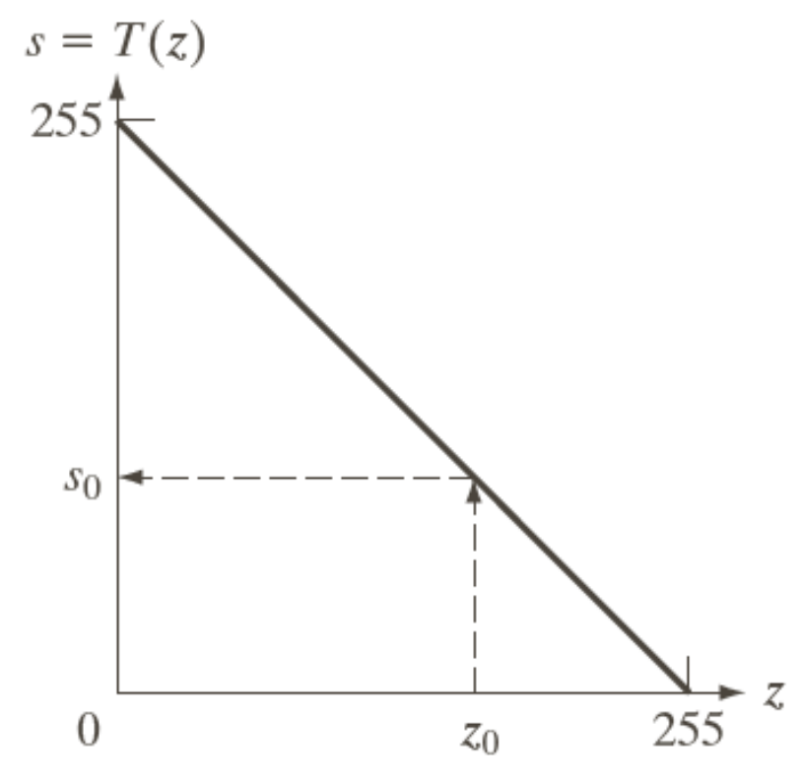
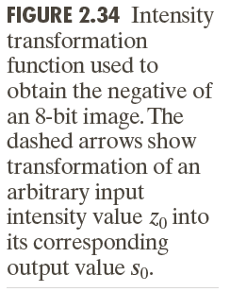
Spatial Operations
Single Pixel Operations (Point Operations), s = T(z)
Neighborhood Operations
Geometric Spatial Transformations and Image Registration
COMSATS University Islamabad, Lahore Campus Digital Image Processing CSD 331

Slide 3
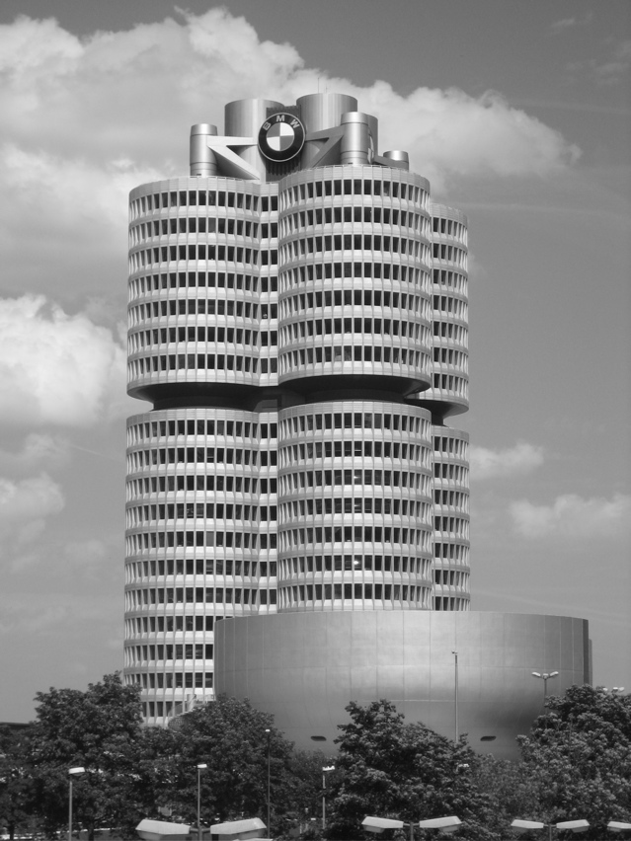
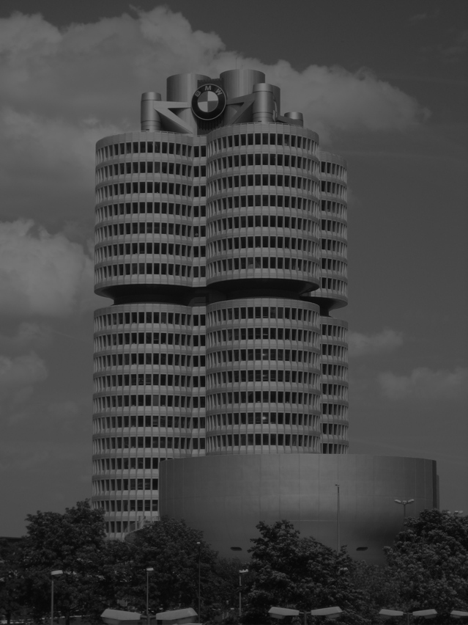
Point Operations
Example:
s = r/2
COMSATS University Islamabad, Lahore Campus Digital Image Processing CSD 331

Slide 4
Spatial Operations - Neighborhood Operations
Neighborhood-oriented operations consist of determining the resulting pixel value at coordinates (x,y) as a function of its original value and the value of (some of) its neighbors, using a convolution operation.
The convolution of a source image with a small 2D array (mask or kernel) produces a destination image.
The convolution mask determines which neighbors are used as well as the relative weight of their original values.
COMSATS University Islamabad, Lahore Campus Digital Image Processing CSD 331

Slide 5
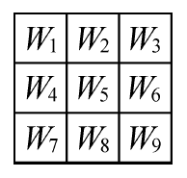
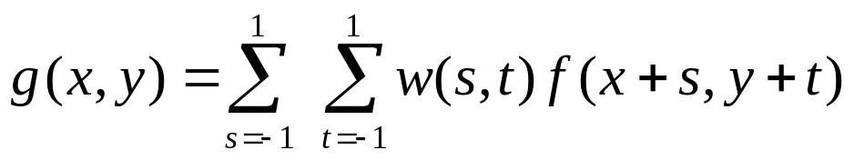
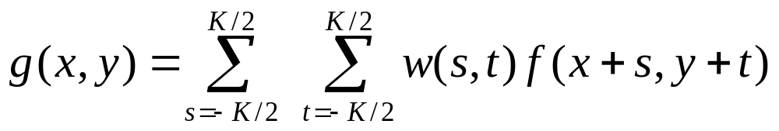
Spatial Operations - Neighborhood Operations
Masks are normally 3×3.
Each mask coefficient can be interpreted as a weight.
COMSATS University Islamabad, Lahore Campus Digital Image Processing CSD 331

Slide 6
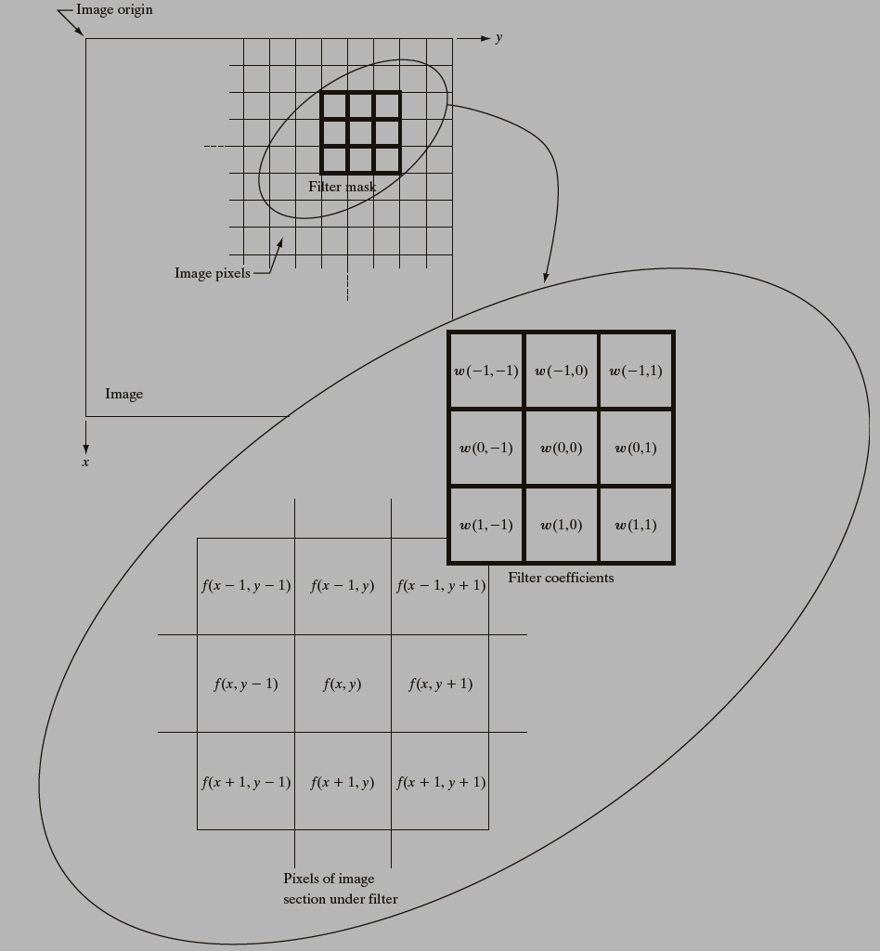
Spatial Operations - Neighborhood Operations
COMSATS University Islamabad, Lahore Campus Digital Image Processing CSD 331

Slide 7
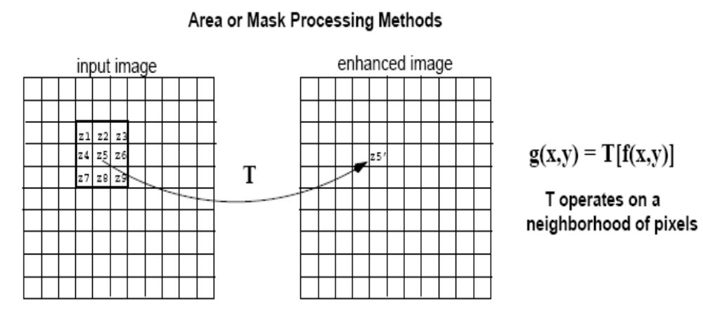
Spatial Operations - Neighborhood Operations
A filtered image is generated as the center of the mask moves to every pixel in the input image.
output image
COMSATS University Islamabad, Lahore Campus Digital Image Processing CSD 331

Slide 8
Spatial Operations - Neighborhood Operations
Problems ?
Assignment (Applying a mask)
COMSATS University Islamabad, Lahore Campus Digital Image Processing CSD 331

Slide 9
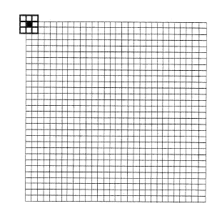
Spatial Operations - Neighborhood Operations
Solutions ?
pad with zeroes
0 0 0 ……………………….0
0 0 0 ……………………….0
COMSATS University Islamabad, Lahore Campus Digital Image Processing CSD 331

